Slide 1
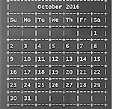
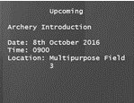
SmartyDo
SmartyDo
Upcoming [12-Oct]
1. User Guide
New task added: Archery
Added #CS2103 User Guide due 12 October 2016
>> Add /d Archery Introduction /st 0900 /loc Multipurpose Field 3
>> add #CS2103 /n User Guide /d 121016

Slide 2
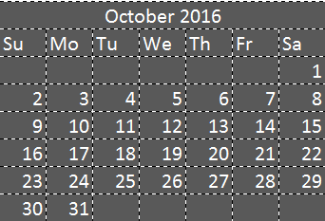
SmartyDo
Upcoming
Task Deleted : Archery Introduction
>> delete 1

Slide 3
SmartyDo
Upcoming
Your previous action delete 1 has been executed
>> Redo

Slide 4
SmartyDo
VisualBox
Welcome to SmartyDo
Enter “Help” to get started or key in any other command to continue where you left off.
MessageBox
>> Command Bar
Notes:
rgb(94,53,177)
rgb(63,81,181)
rgb(57,73,171) rgb(48,63,159)- upcoming 2
Rgb(238,238,238) – calendar text
rgb(255,196,0) –highlight date
179,157,219-calendar latest
rgb(57,73,171)
=================
rgb(69,39,160) top bot
rgb(179,157,219) message
Rgb(94,53,177)-right
rgb(98,0,234)– calendar highlight
rgb(126,87,194) left

Slide 5
SmartyDo
Upcoming [12-Oct]
User Guide
#Cs2103 due 12-oct-16
Upcoming [12-Oct]
1. User Guide
Showing incomplete tasks due on 12 October 2016.
>> view 121016

Slide 6
SmartyDo
Upcoming [12-Oct]
User Guide
#Cs2103 due 12-oct-16 by 14:00
Upcoming [12-Oct]
1. User Guide
Updated 1. User Guide Time to 14:00
>> edit 1 time 1400

Slide 7
SmartyDo
Upcoming [12-Oct]
User Guide
#Cs2103 due 12-oct-16
Upcoming [12-Oct]
1. User Guide
Undone the following command:
Updated 1. User Guide Time to 14:00
>> undo

Slide 8
SmartyDo
Upcoming [12-Oct]
User Guide
#Cs2103 due 12-oct-16 by 14:00
Upcoming [12-Oct]
1. User Guide
Re-executed the following command:
Updated 1. User Guide Time to 14:00
>> redo

Slide 9
SmartyDo
Upcoming [12-Oct]
You have no upcoming tasks!
Your task: UserGuide #CS2103 due 12-oct-16 has been deleted
>> delete 1

Slide 10
SmartyDo
Upcoming [12-Oct]
User Guide
Your have completed task :
UserGuide #CS2103 due 12-oct-16
>> Done 1

